Slide 1
Financial Time-Series Modeling
Ray
Angel

Slide 2
Agenda
Project Objective
Data Preparation
Data Pre-Processing
Data Modeling
Data Model Validation
Forecasting
Next Steps

Slide 3
Project Objective
The intent of the project was to optimize an investment portfolio. To achieve this goal we need to:
Collect the data from multiple sources (e.g., Yahoo finance, federal reserve)
Pre-process the data to perform the necessary transformation
Perform the time-series modeling (e.g., ARIMA Model, Factor Model)
Validate your time-series model
Find the efficient frontier for optimal portfolio
Generate forecast for each security

Slide 4
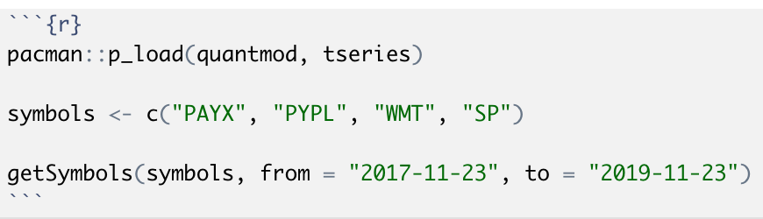
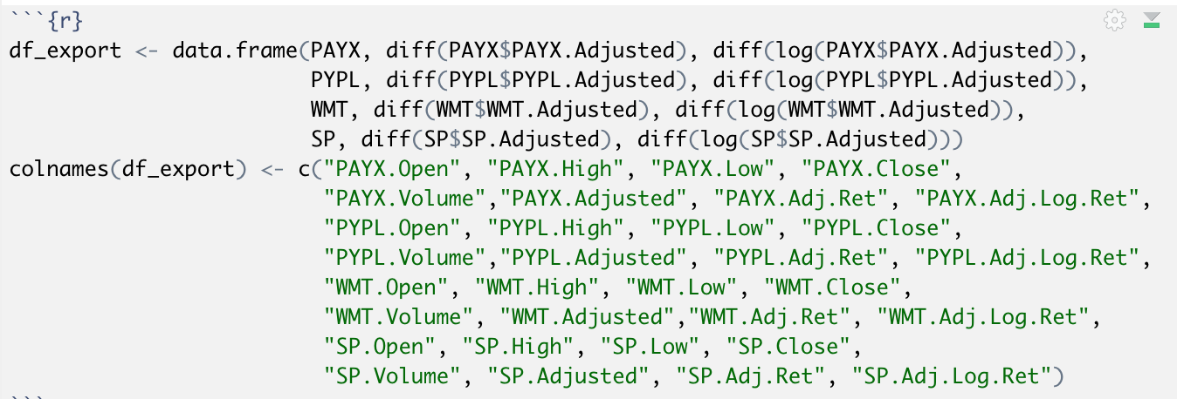
Data Preparation
Time Interval:
Start: November 23, 2017
End: November 23, 2019
Produces 503 Observations per Security
Securities - GICS Sector > GICS Sub Industry
Consumer Staples > Hypermarkets & Super Centers
WMT = Walmart
Information Technology > Data Processing & Outsourced Services
PAYX = PayCheck Inc
PYPL = Paypal
Market
SP = S&P 500
Notes:
Key Pointers:
Global Industry Classification Standard (GICS)
The top snippet just show the necessary code to pull the data
The bottom snippet shows the transformations we need to perform in addition to getting the symbols financial information.

Slide 5
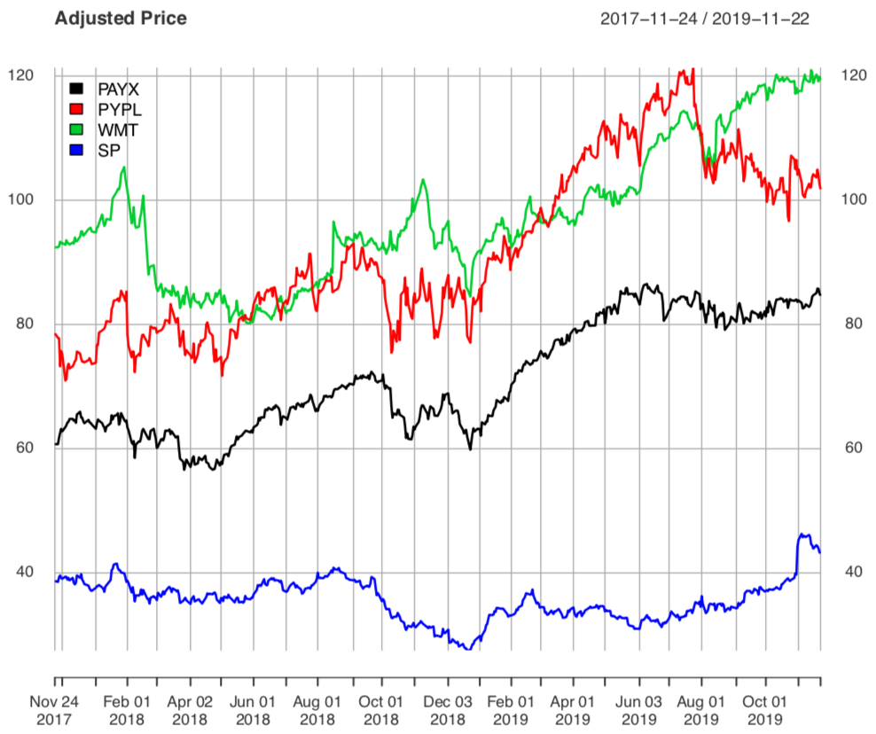
Data Pre-Processing
Adjusted price for each security is presented in different ranges.
Can be improved by obtaining the return

Slide 6
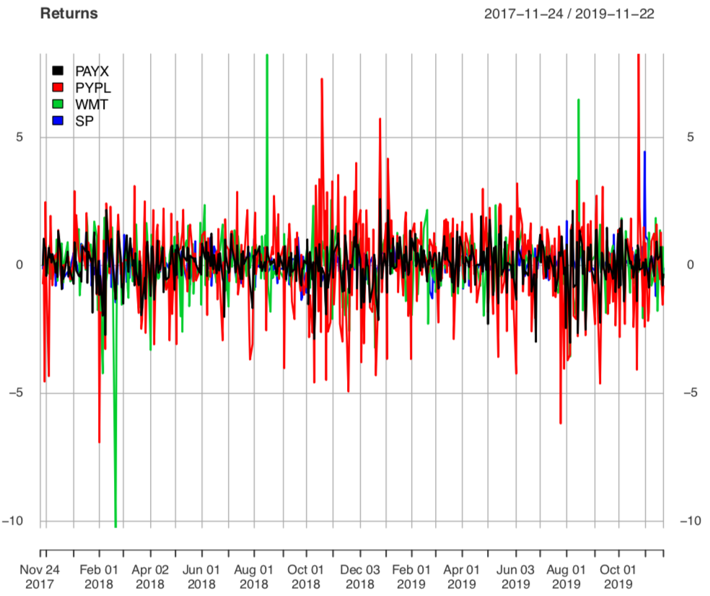
Data Pre-Processing (Continuation)
We can start observing mean-reversion, a common condition that validates the stationarity assumption.
However, we can observe that the color distribution is not even between securities.

Slide 7
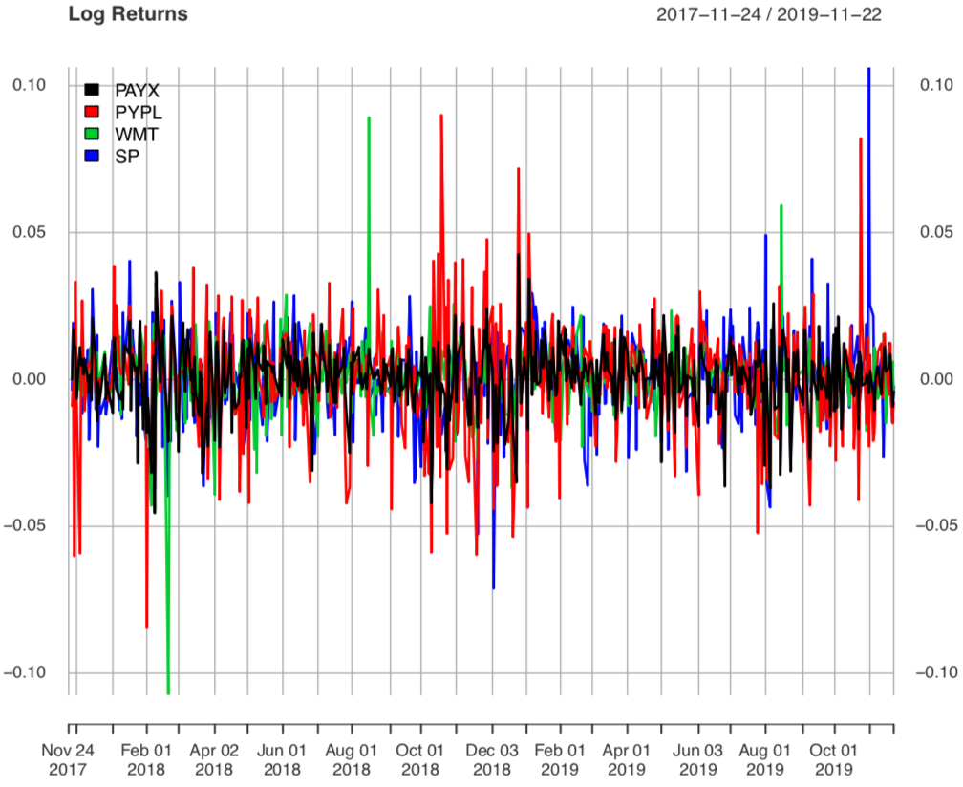
Data Pre-Processing (Continuation)
The color distribution seems to be evenly distributed between the multiple securities analyzed in this project.

Slide 8
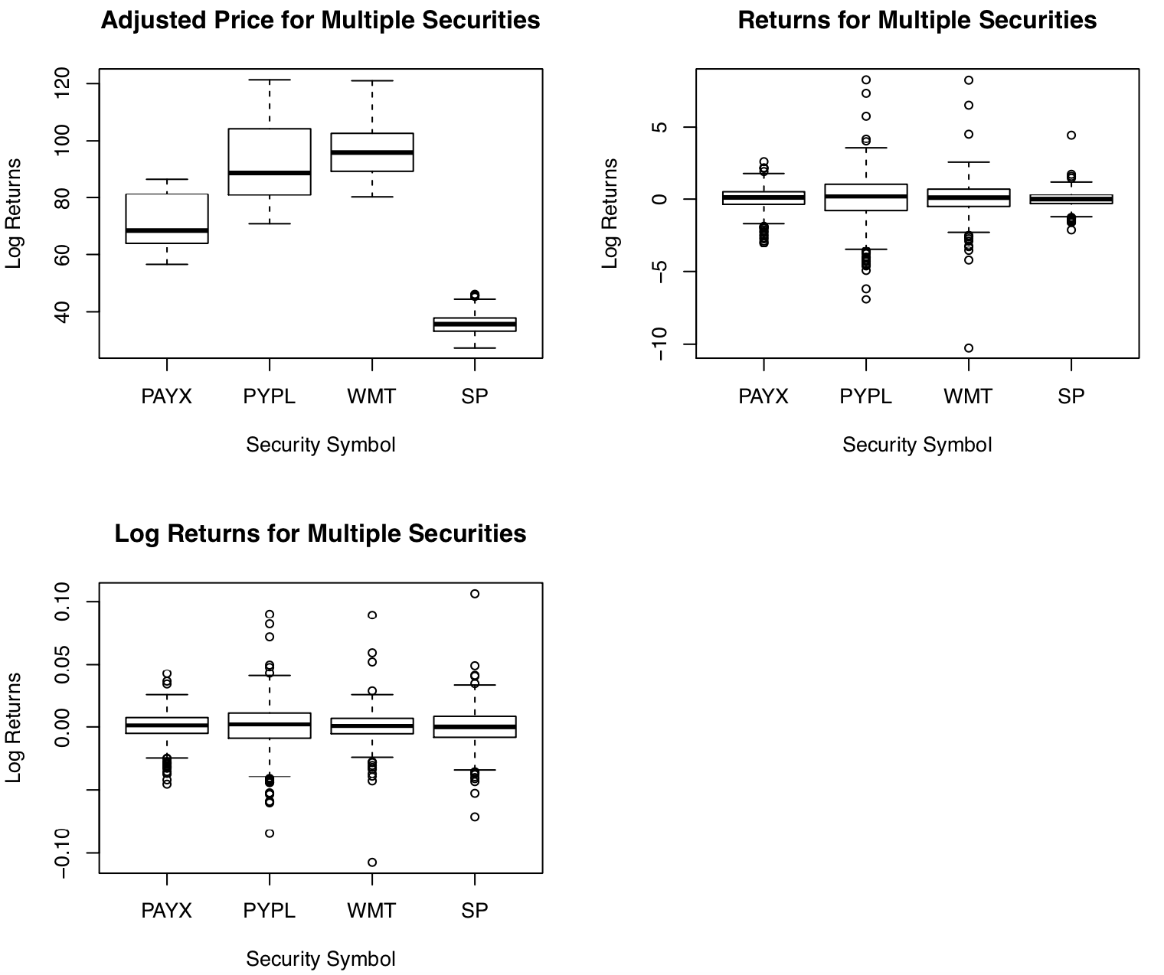
Data Pre-Processing (Continuation)
The box-plot for each one of the transformation further demonstrates the value of using Log Returns.

Slide 9
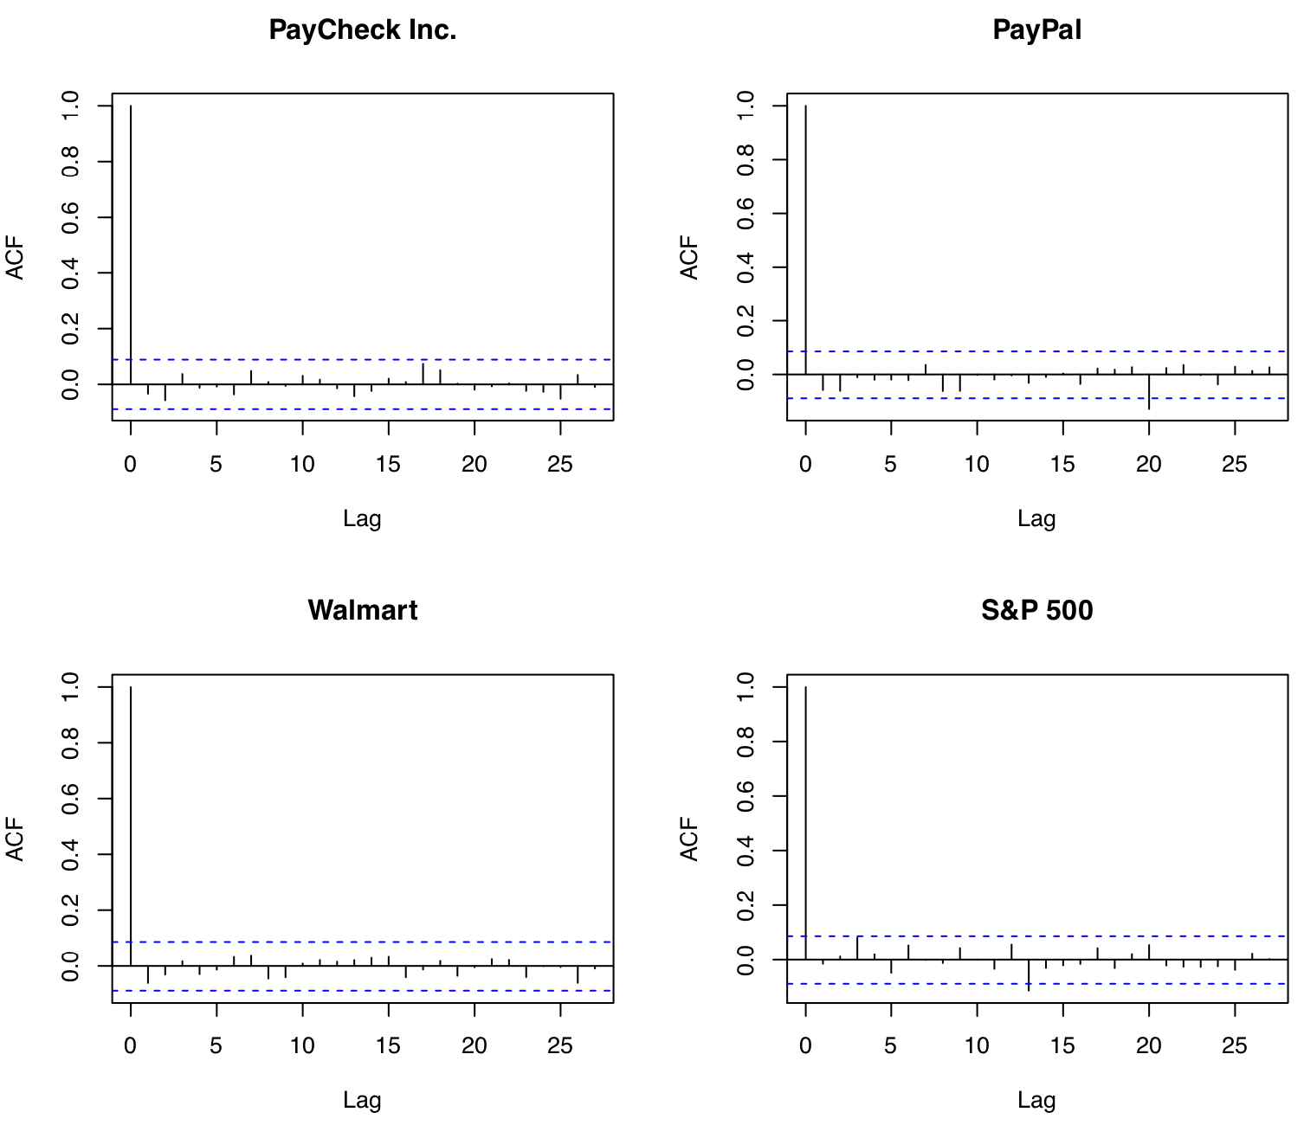
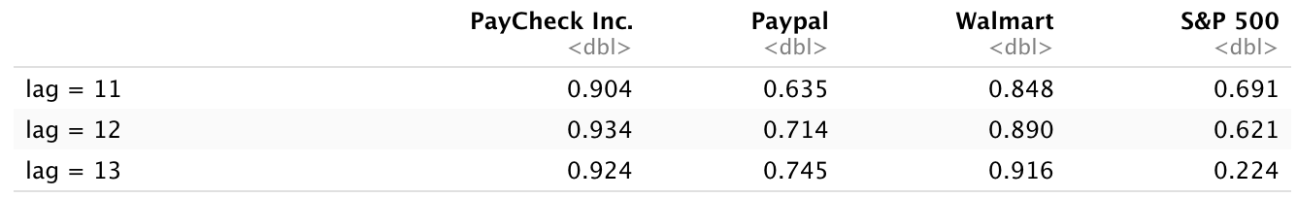
Data Modeling
The autocorrelation function shows that the log returns satisfy the stationary assumption
Only PayPal and S&P 500 had autocorrelation elements crossing the lower test boundaries
Ljung-Box test shows the best p-value for PayCheck at lag 12

Slide 10
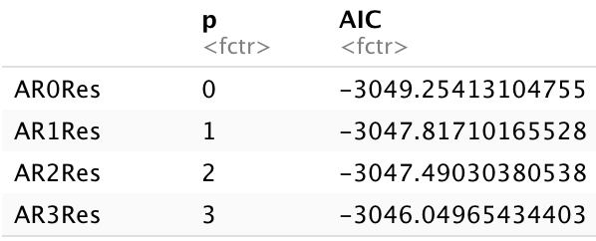
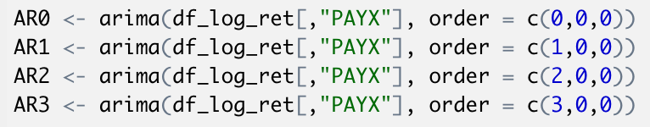
Data Modeling (Continuation)
ARIMA modeling consist of adjusting order values for p, q, and d
Modeling AR or MA could be the simplest approach
AR(0) and MA(0) presented the best AIC values for PayCheck Inc. security

Slide 11
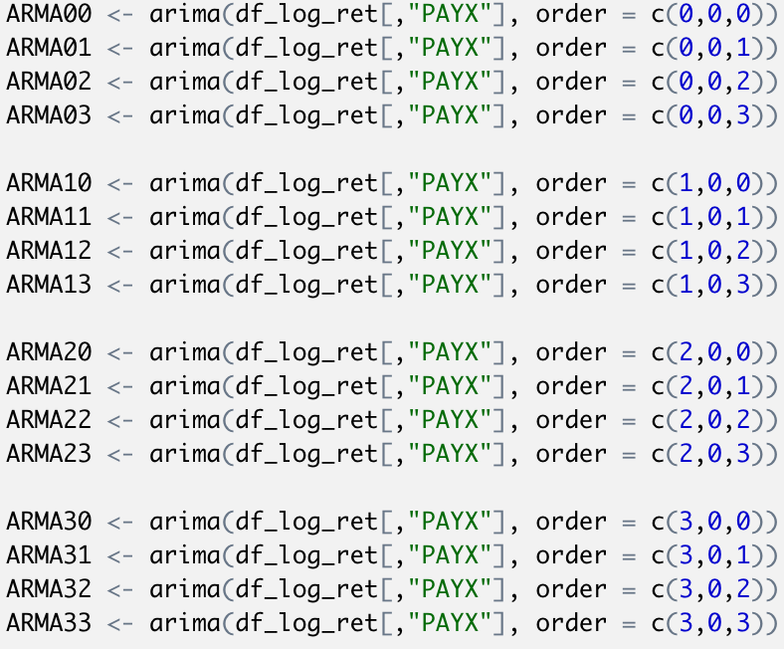
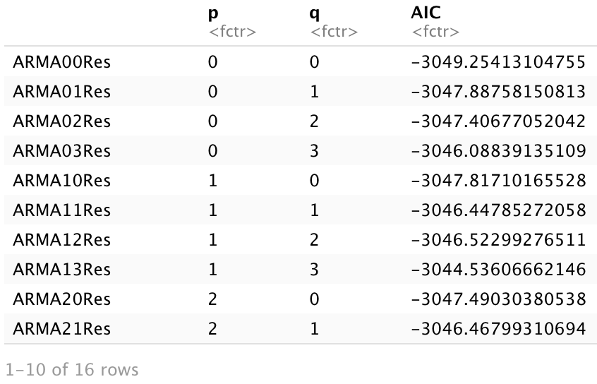
Data Modeling (Continuation)
ARMA and ARIMA modeling could take more time to be performed as it considers parameters p, q, and d
“auto.arima” can help find the best combination of p, q, and d possible
ARIMA (0,0,0) and ARMA(0,0) presented the best AIC values for PayCheck Inc.

Slide 12
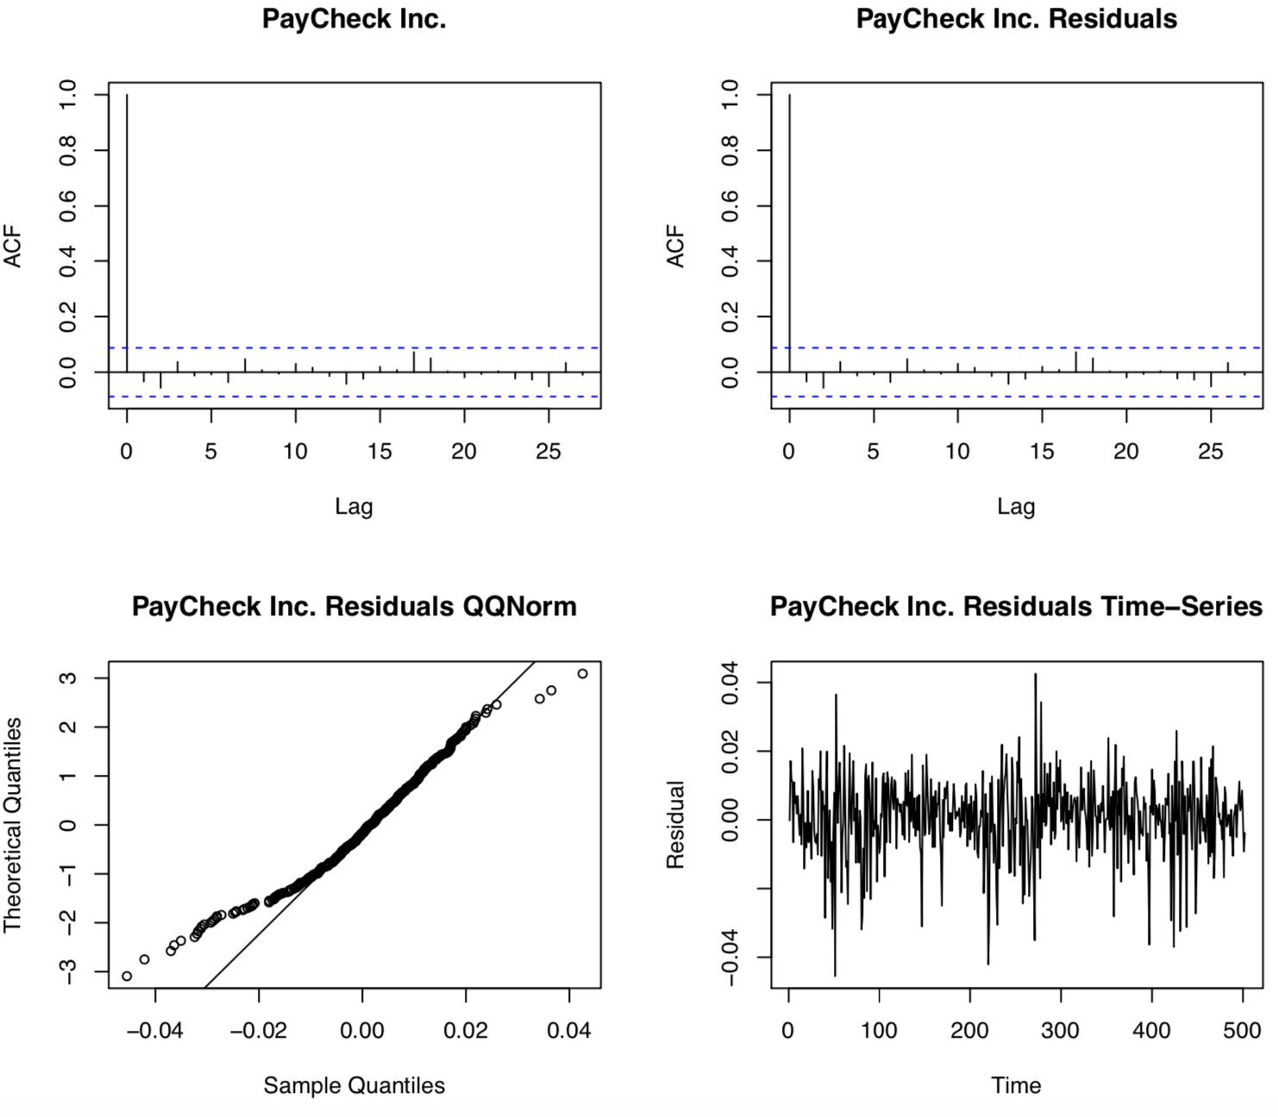
Data Model Validation
ACF plots confirms that the residuals follow the same autocorrelation than the original dataset. This similarity makes the ARIMA(0,0,0) a good model for forecasting.
The QQnorm plot of PayCheck Inc. reiduals present heavy tails, a common characteristic of t-distributions.
The time-series plot of PayCheck Inc. residuals shows some volatility

Slide 13
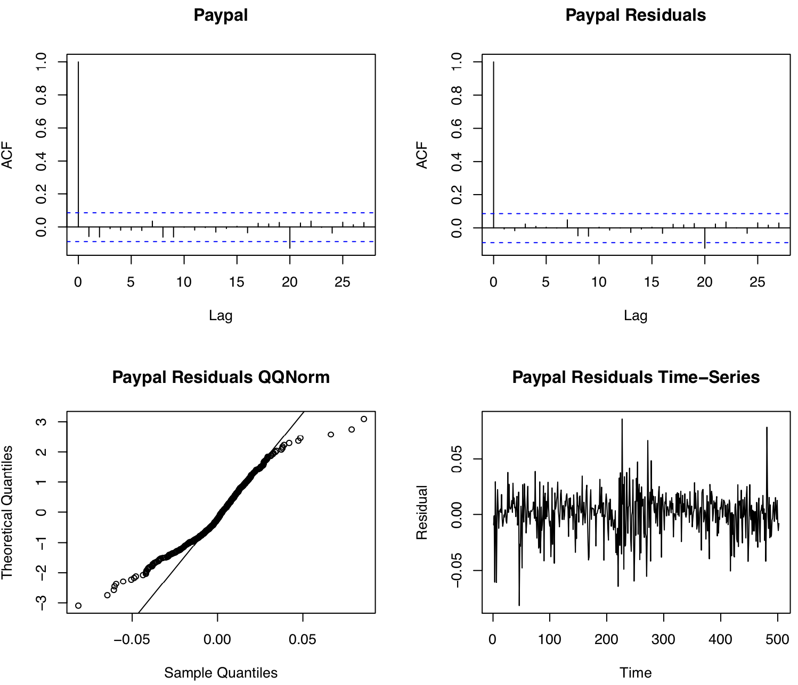
Data Model Validation (Continuation)
ACF plots presented confirms that the residuals follow the same autocorrelation than the original dataset; in particular at lag 20 both ACF plots present an autocorrelation that crosses the lower test bound. This similarity makes the ARIMA(1,0,1) {i.e., ARMA(1,1)} a good model to be used for forecasting.
The QQnorm plot of Paypal residuals present heavy tails, a common characteristic of t-distributions.
The time-series plot of Paypal residuals shows some volatility.

Slide 14
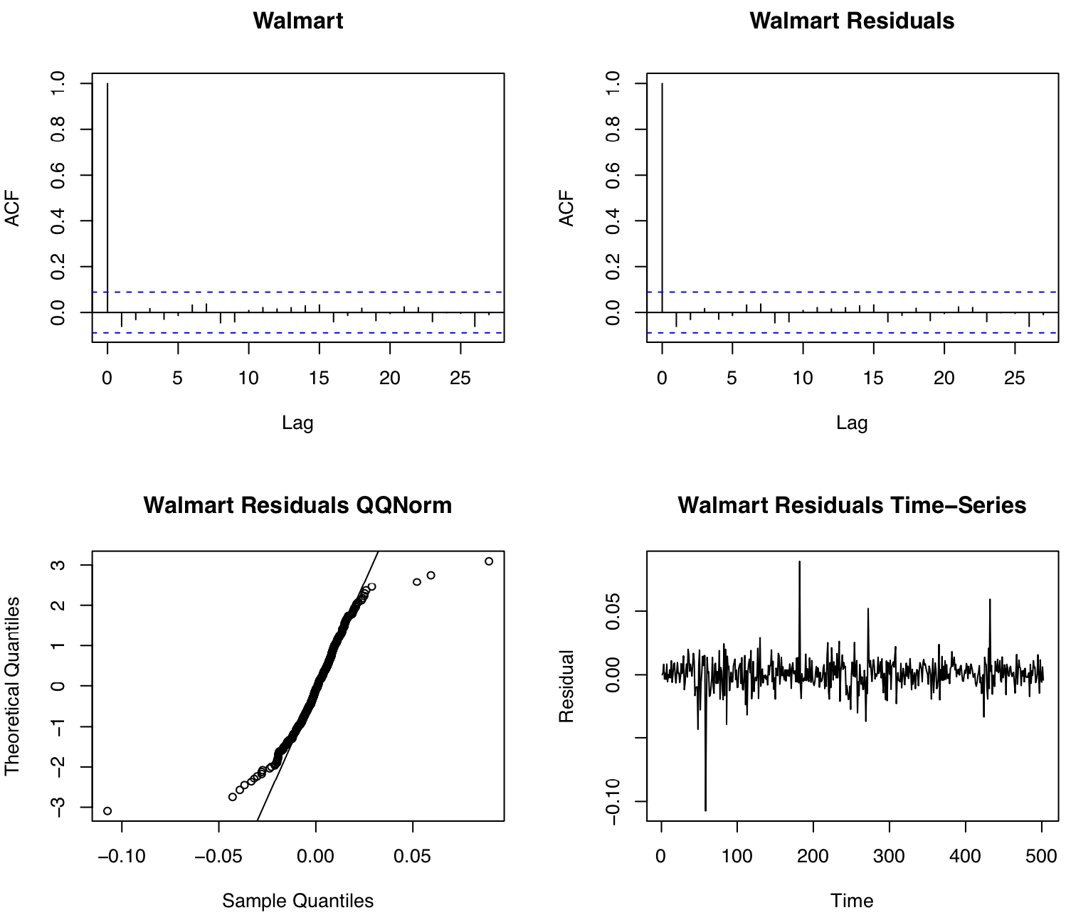
Data Model Validation (Continuation)
ACF plots confirms that the residuals follow the same autocorrelation than the original dataset. This similarity makes the ARIMA(0,0,0) a good model to be used for forecasting.
The QQnorm plot of Walmart residuals present heavy tails, a common characteristic of t-distributions.
The time-series plot for Walmart residuals shows some volatility

Slide 15
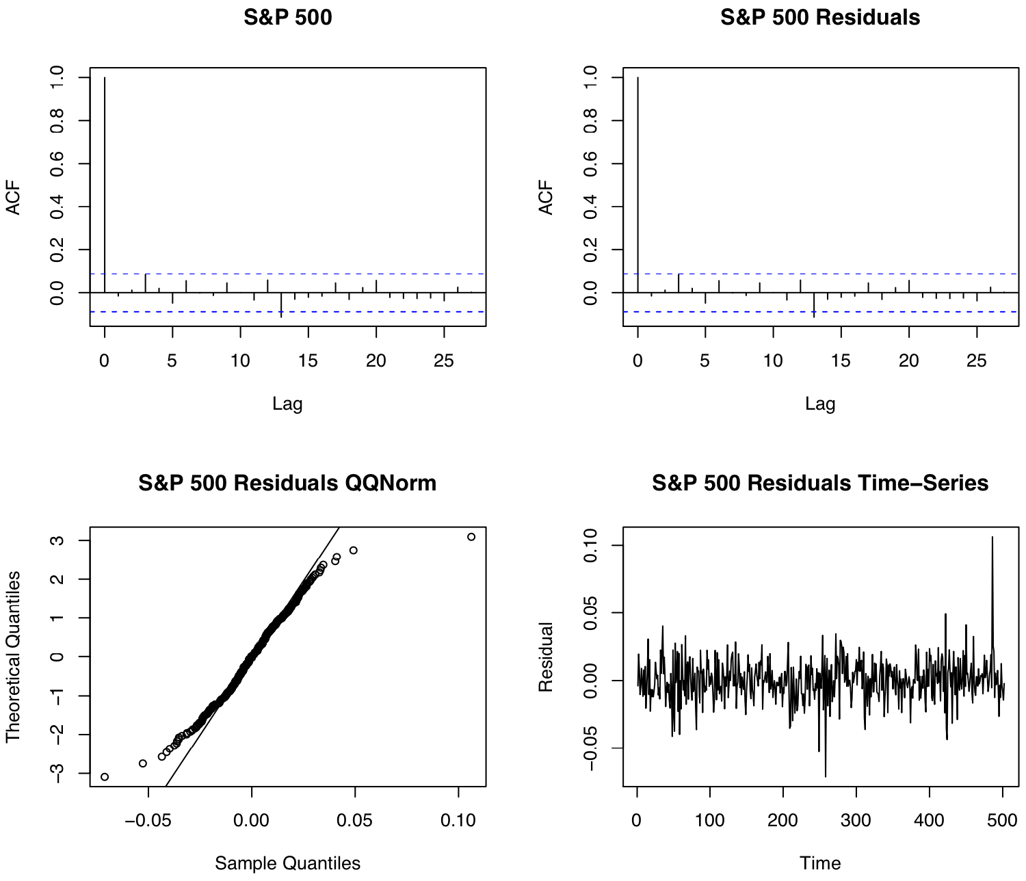
Data Model Validation (Continuation)
ACF plots confirms that the residuals follow the same autocorrelation than the original dataset; in particular at lag 12 both ACF plots present an autocorrelation that crosses the lower test bound. This similarity makes the ARIMA(0,0,0) a good model to be used for forecasting.
The QQnorm plot of S&P 500 residuals present heavy tails, a common characteristic of t-distributions.
The time-series plot of S&P 500 residuals shows some volatility

Slide 16
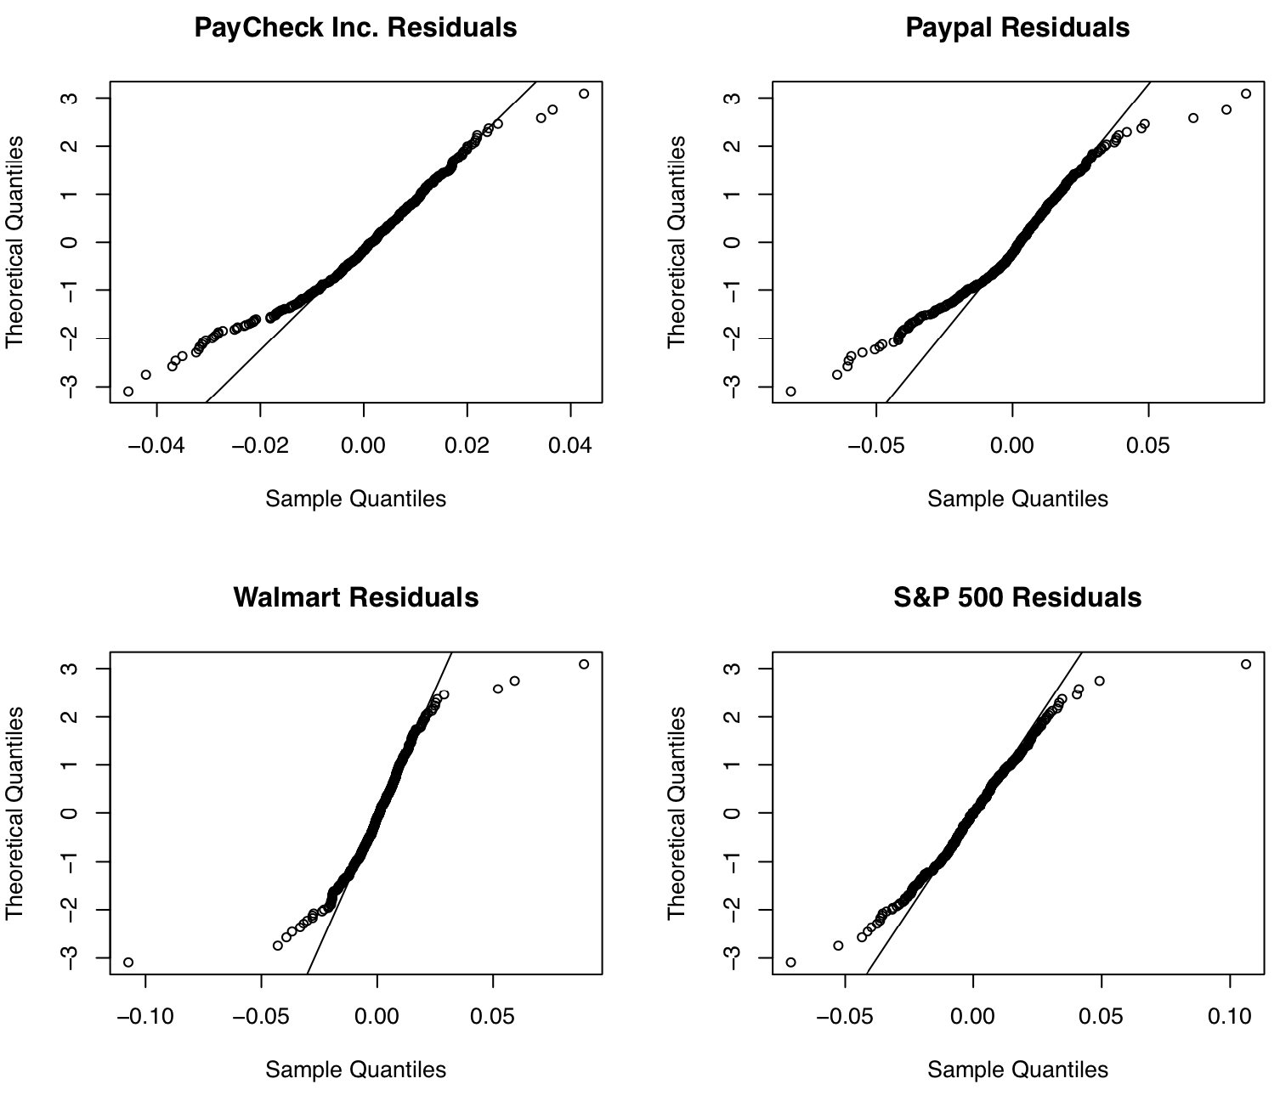
Data Model Validation (Continuation)
All securities presented heavy tails when plotting QQNorm
S&P 500 is the security that follows the line closer than any other security.

Slide 17
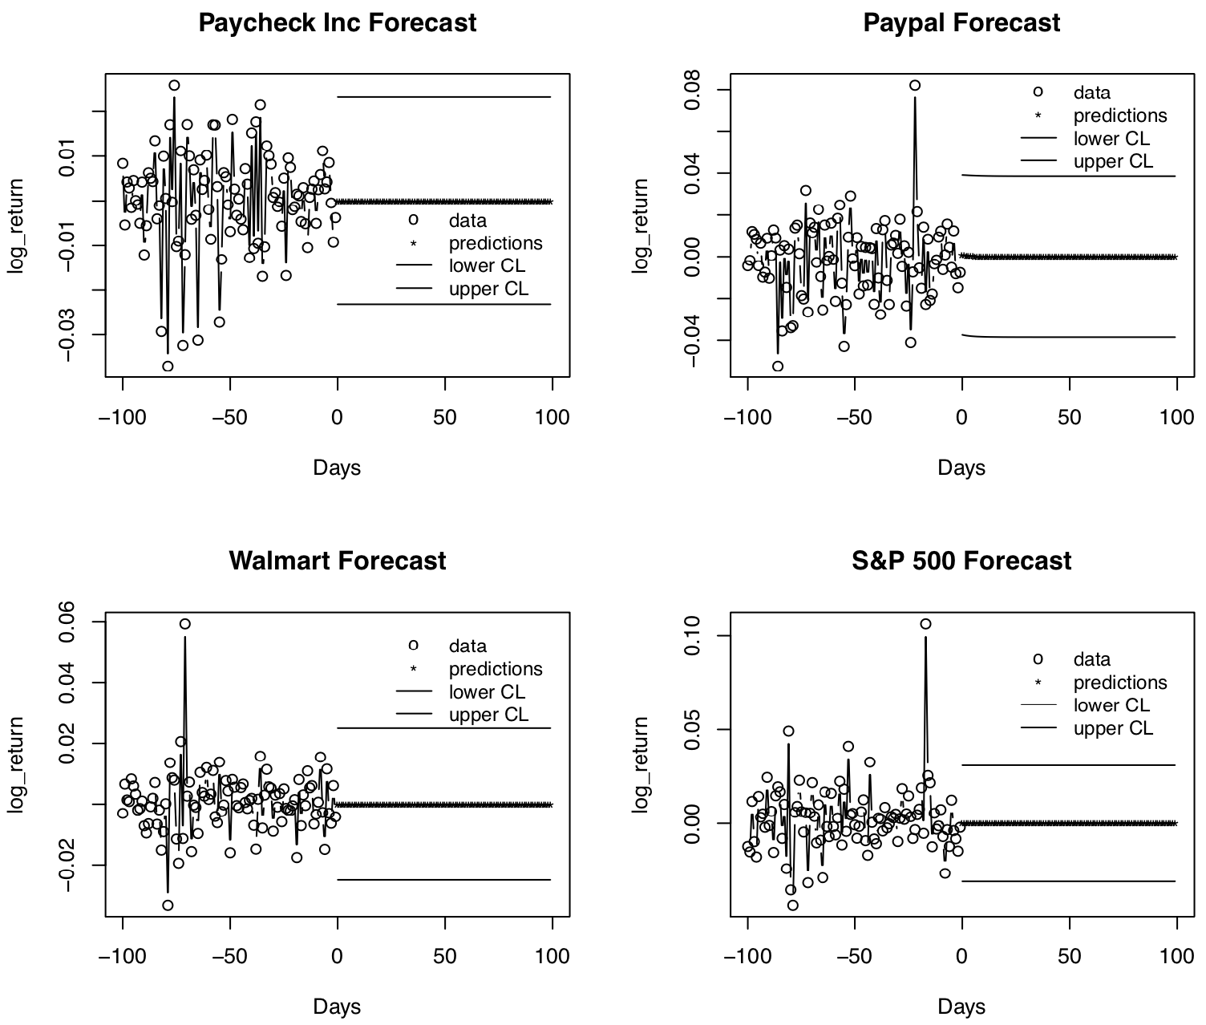
Forecasting
The S&P 500 shows the shorter distance between the predictions and the lower and upper CL. This could make S&P 500 the best asset for investment.

Slide 18
Next Steps
Update
Update data prep section to include federal reserve information such as the risk-free asset.
Update
Update data modeling section to include the Factor Model
Complete
Complete the efficient frontier to find the optimal portfolio

